Slide 1

mecke engineering information
Academic Package
For Autodesk Vault
Kai Mecke info@mecke.net
Notes:
Persönlicher Hintergrund:
Kurze Vorstellung:

Slide 2
Configuration of the academic lifecycles
Academic Engineering Release Process:
Based on flexible Release Process
Edit
Everyone
In Check
Tutor
Lecturer
Released
Student : R W -
Tutor: R - -
Lecturer: R W D
Admin: R W D
Student: R - -
Tutor: R - -
Lecturer : R W D
Admin: R W D
Student : R - -
Tutor: R - -
Lecturer: R - -
Admin: R W D
Lecturer
Lecturer
When you create a Vault instance with the configuration file, then you will have the lifecycle available,
but since there are no user groups in place yet, you have the assign the rights.

Slide 3

Vault Architecture example
Server Side
Multiple Clients
External User
z.B. Mecke
(virtual ?) Clients
VPN & RDP | Horizon | Citrix
Inventor 201x
Vault Professional Client 201x
VPN & RDP | Horizon | Citrix
ASDK_VLT_Server
MS-SQL DB @ DataCenter
@ localhost
ADMS Console
Autodesk Vault Pro 20xx
Vault Professional
Client 2018
Instance: AUTODESKVAULT
Filestore
Notes:
Check that you have at least 4 CPU cores (1xWindows, 1xSQL, 1xADMS, 1xZombie processes which might freeze your system)

Slide 4
Get started for students
You are starting to work on a new windows account? You probably want to get started with your students like this:
(Start & Close Inventor to register file extensions)
Vault Client Login
Get the Project file from the Vault
Double-Click the project file to start Inventor
Go to the Vault Addin in Inventor and Login into Vault (second independent connection)
Open a file from the library as example
Create you own Parts & Assemblies, Dwg…

Slide 5
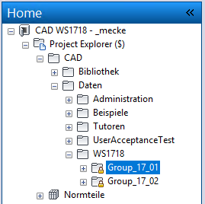
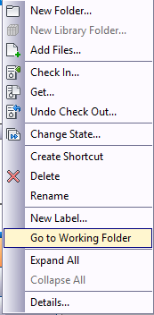
Work in the folder structure
In the Vault Client navigate to your Group folder
In the context menu find the “Got to Working Folder” command to create the local folder structure to initially save files.
Notes:
XXX

Slide 6
Configuration: Categories and Properties
Engineering (Category)
  Rules: Inventor Files
  Lifecycle: Academic Engineering Release Process
  Properties: None
  Revision schema: Standard Alphabetic Format
Basic
  Rules : Documents (doc, txt, etc.)
  Lifecycle: Academic Simple Release Process
  Properties: None
  Revision schema: None
Notes:
XXX

Slide 7
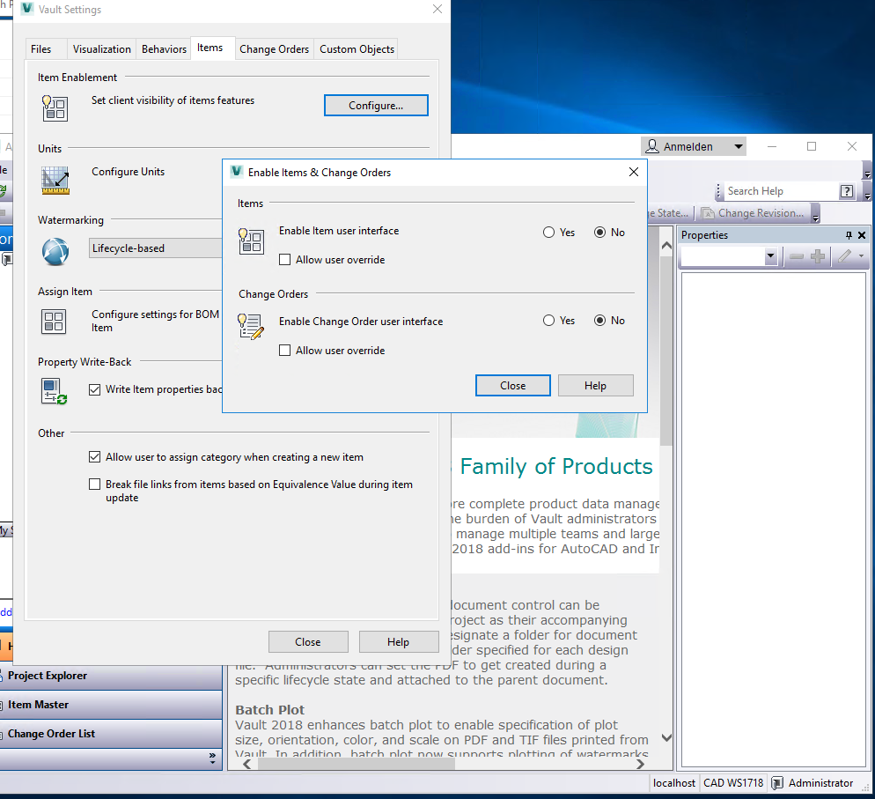
Item View
Disable the item and ECO mangement, if you do not want to work with this.

Slide 8
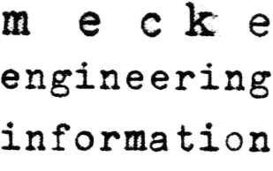
Contact
Dr.-Ing. Kai Mecke
Feldberg Str. 17
61440 Oberursel
Mail info@mecke.net

